Slide 1
MALAIGNANT COMMENTS CLASSIFIER PROJECT

Slide 2
INTRODUCTION <Business Problem Framing
Business Goal:
Our goal is to build a prototype of online hate and abuse comment classifier which can used to classify hate and offensive comments so that it can be controlled and restricted from spreading hatred and cyberbullying
The proliferation of social media enables people to express their opinions widely online. However, at the same time, this has resulted in the emergence of conflict and hate, making online environments uninviting for users. Although researchers have found that hate is a problem across multiple platforms, there is a lack of models for online hate detection. Online hate, described as abusive language, aggression, cyberbullying, hatefulness and many others has been identified as a major threat on online social media platforms. Social media platforms are the most prominent grounds for such toxic behavior
There has been a remarkable increase in the cases of cyberbullying and trolls on various social media platforms. Many celebrities and influences are facing backlashes from people and have to come across hateful and offensive comments. This can take a toll on anyone and affect them mentally leading to depression, mental illness, self-hatred and suicidal thoughts.

Slide 3
The purpose of the literature review is to:
Identify the foul words or foul statements that are being used.
Stop the people from using these foul languages in online public forum. To solve this problem,
we are now building a model using our machine language technique that identifies all the foul language and foul words, using which the online platforms like social media principally stops these mob using the foul language in an online community or even block them or block them from using this foul language. I have used 5 different Classification algorithms and shortlisted the best on basis on the metrics of performance and I have chosen one algorithm and build a model in that algorithm.

Slide 4
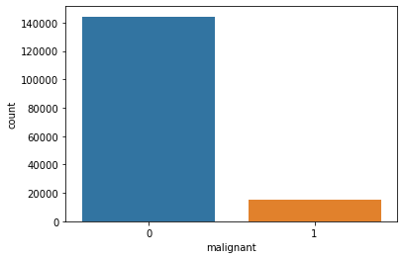
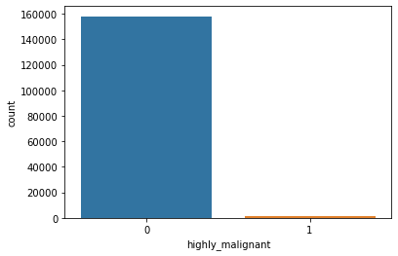
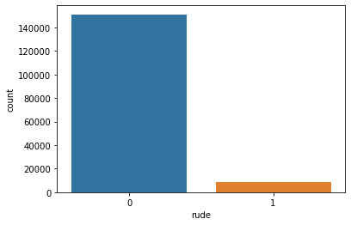
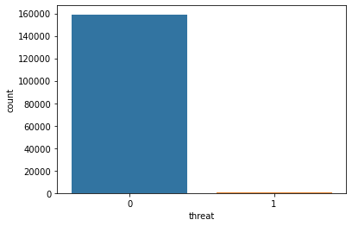
Analytical Problem Framing

Slide 5
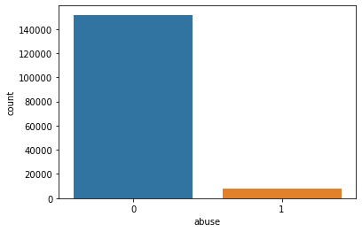

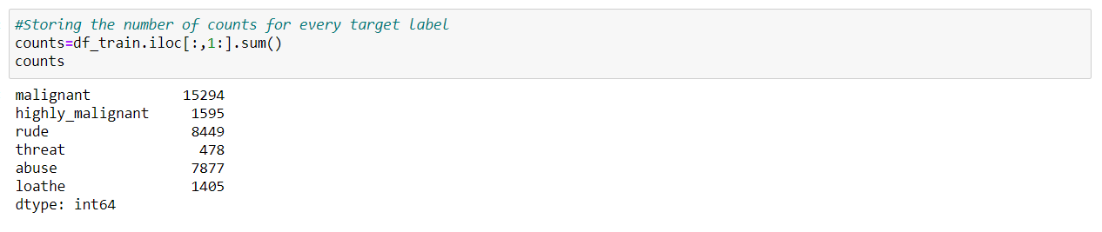
We can see that there only minimum number of columns in 'malignant', 'highly malignant', 'rude', 'threat', 'abuse', 'loathe' and remaining all in 0.

Slide 6
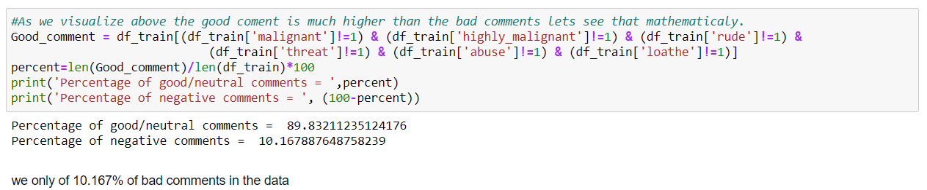
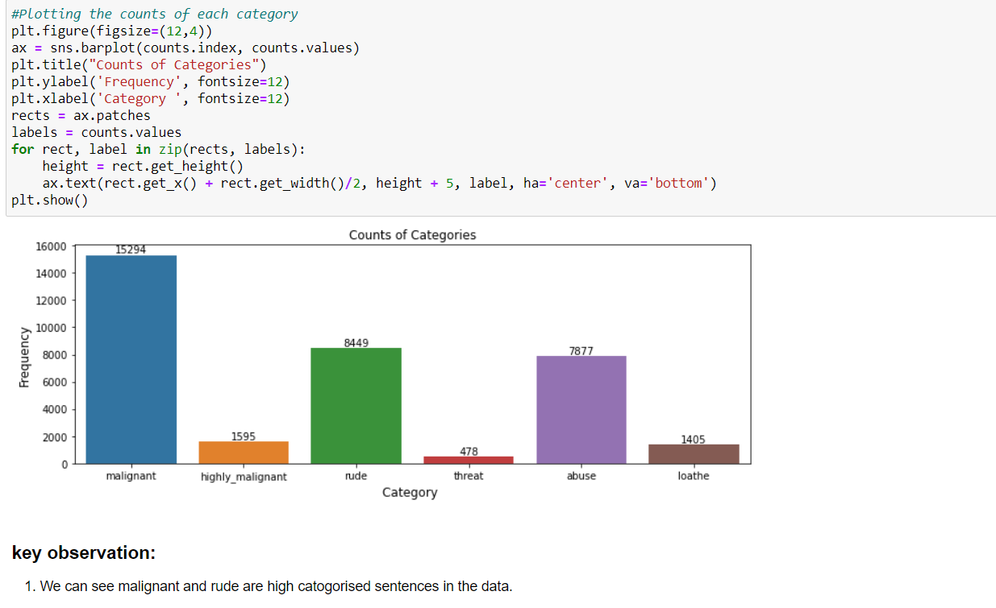
So, only 10% of the data is getting classified as malignant comments data is unbalanced.

Slide 7
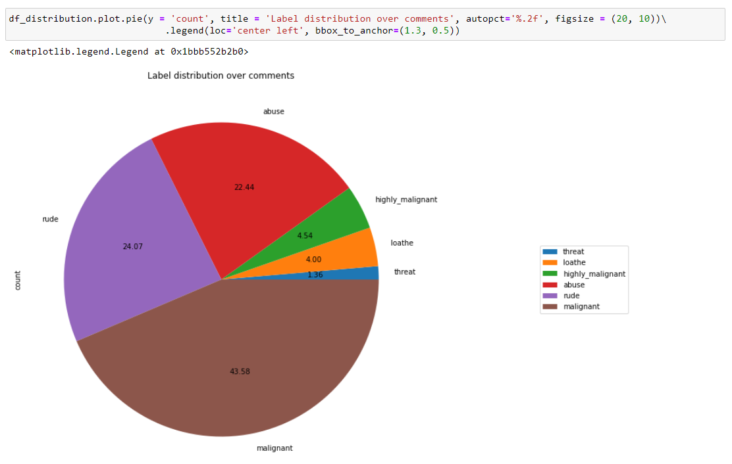
We can see malignant and rude are high categorised sentences in the data.
As we see above malignant, and rude sentence are high classified and threat, loathe are least classified.

Slide 8
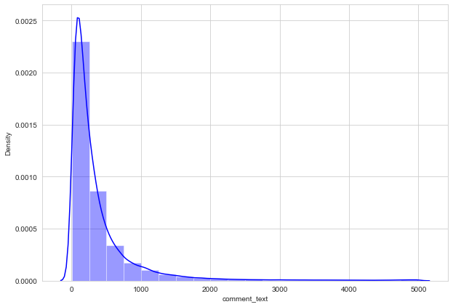
We can see that few sentences are really long but most of the sentence are small.

Slide 9
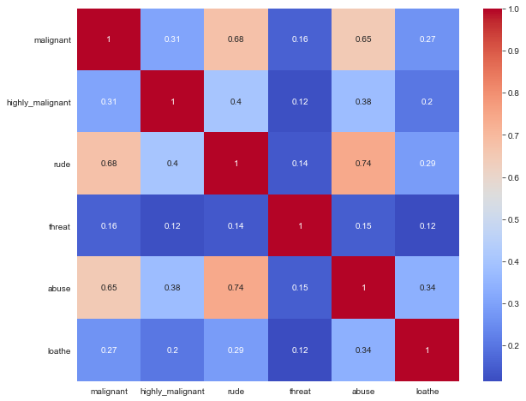
We can see more corelations in the variables, Abuse have more corelation with malignant and rude.
Rude has more positive corelation with malignant
we don’t have any negative corelations in the data.

Slide 10
The data set includes:
Malignant: It is the Label column, which includes values 0 and 1, denoting if the comment is malignant or not.
Highly Malignant: It denotes comments that are highly malignant and hurtful.
Rude: It denotes comments that are very rude and offensive.
Threat: It contains indication of the comments that are giving any threat to someone.
Abuse: It is for comments that are abusive in nature.
Loathe: It describes the comments which are hateful and loathing in nature.
ID: It includes unique Ids associated with each comment text given.
Comment text: This column contains the comments extracted from various social media platforms

Slide 11
EDA
I have started in clearing the unwanted column. Id have all unique values so I dropped id
Importing required libraries.
Cleansing and preprocessing the data.
Word to Vectors (preprocessing)
As a part of preprocessing I imported TFIDF vectorizer to convert words to vectors.
Imputing these vectors I have trained the model
Hardware and Software Requirements
Python 3.8.
NumPy.
Pandas.
Matplotlib.
Seaborn.
SciPy

Slide 12
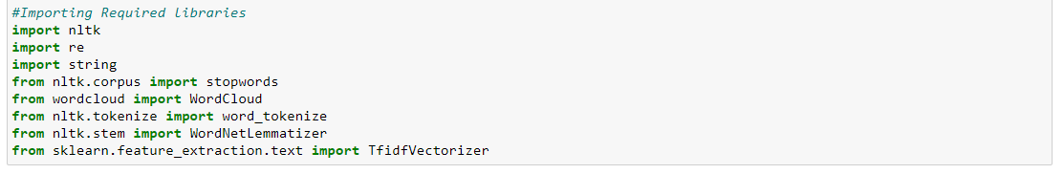
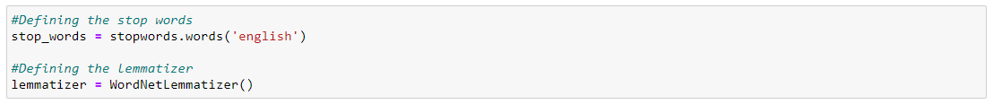
Data Cleansing
<Importing the Required Libraries>
<After importing all the required libraries, I have defined stopwords and lemmatize to a variable>

Slide 13
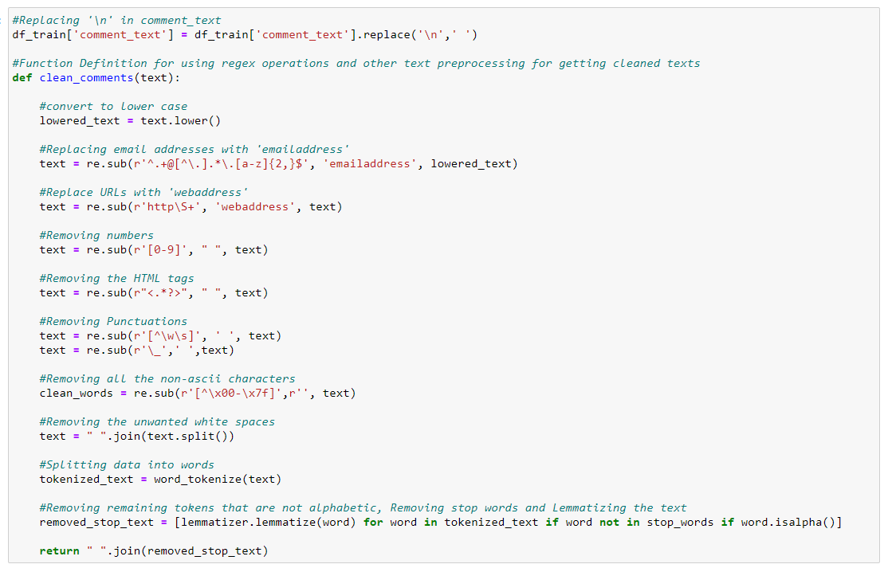
<Post which I have defined a function for cleaning the data>

Slide 14
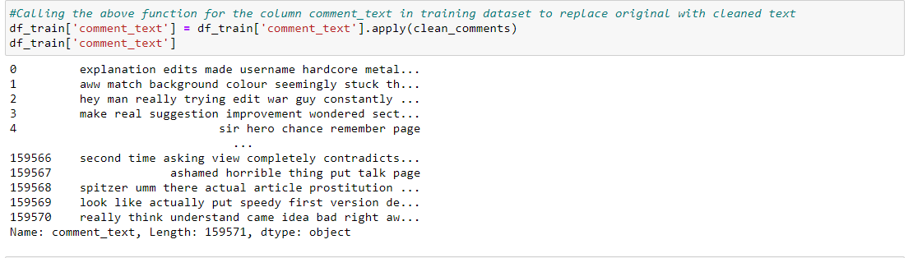
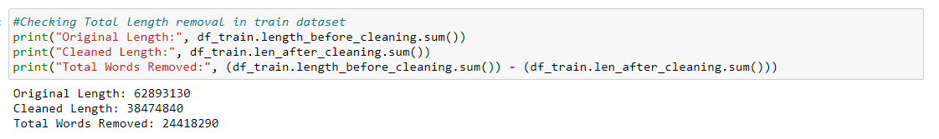
<Post on creating a function I have passed my data into the same to clean it>

Slide 15
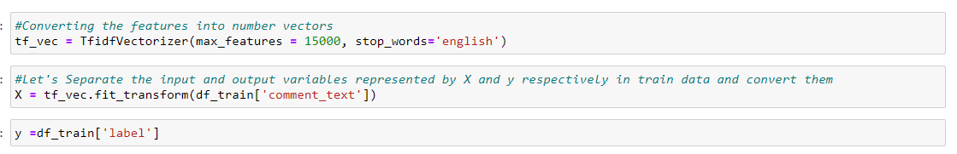
<Word -Vec>
And I have split the data into two parts X and y and made them ready for training. I have created a new feature name label and summed all the other numerical column and changed the output as binary i.e., if the sentence is categorised as malignant it will be 1 or else it will be 0

Slide 16
INSIGHTS AND MODEL BUILDING
Insights
Using wordcloud I have build multiple insights.
Model building
I have trained the data with eight different model and have sorted one on basis of the performance
Hyper Parameter tuning
Using GridSearch CV I have tuned the model for increase in performance

Slide 17
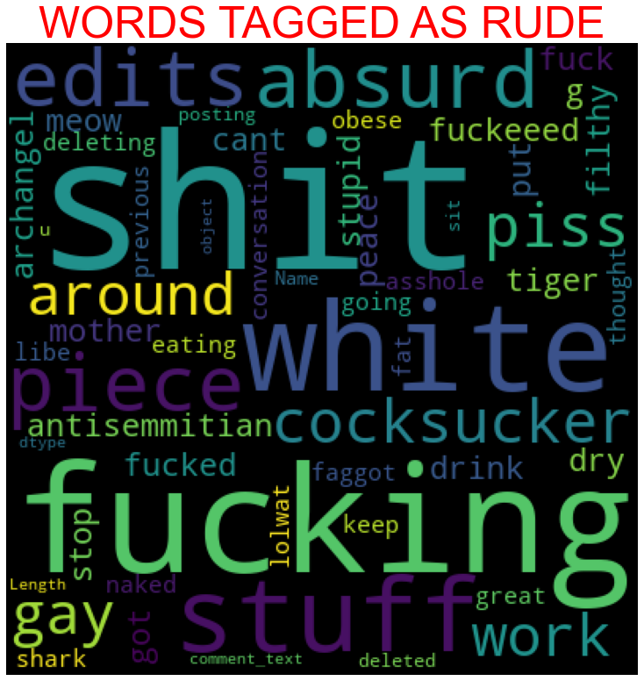
WordCloud
Key observation.
We can see the foul words that are mostly used in malignant classified sentences we are seeing top 400 words the words which are bigger in size are mostly used.

Slide 18
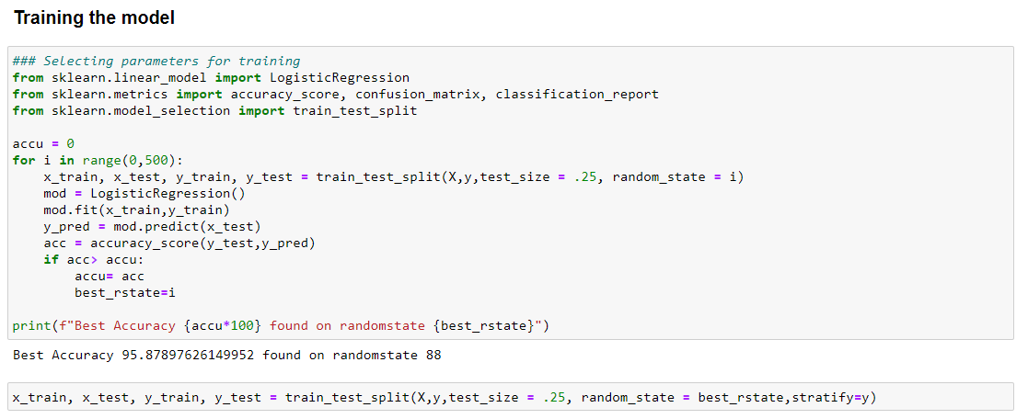
Model/s Development and Evaluation

Slide 19
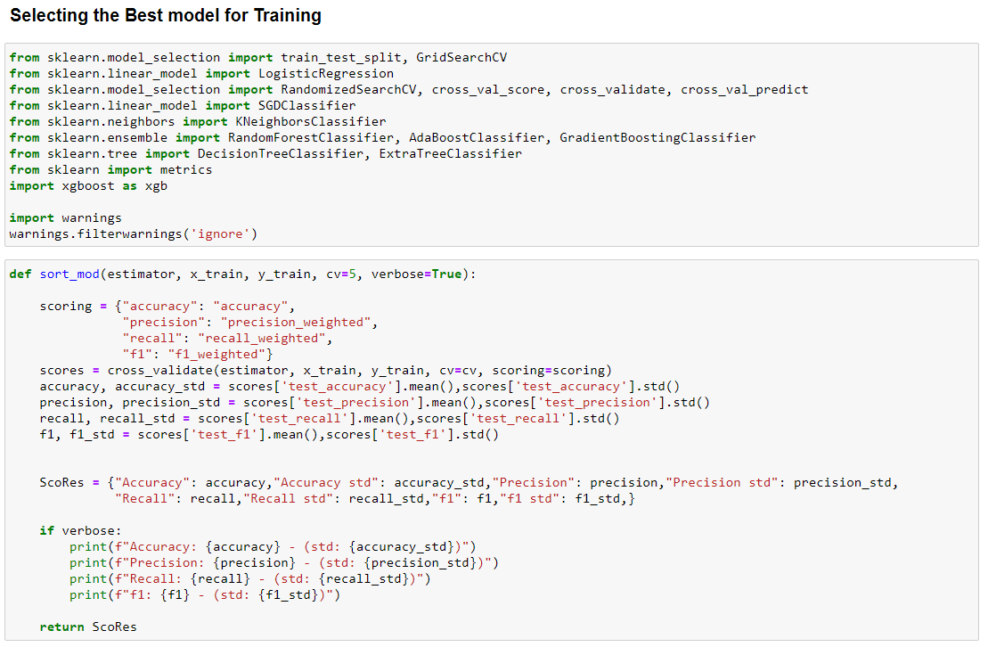

Slide 20
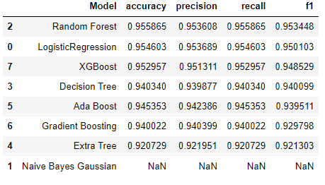
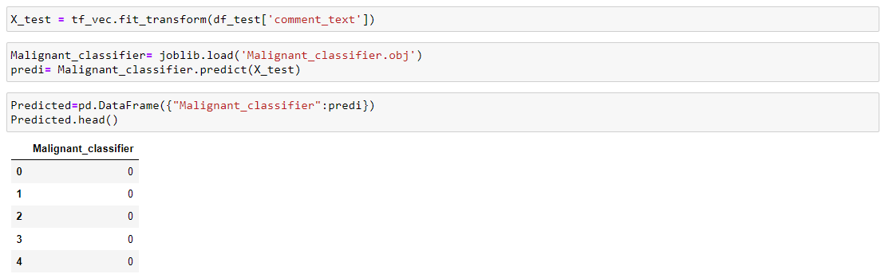
<Shortlisting the trained model>
As we can see above Random Forest tops the chart, I have selected Random Forest model as my final model and I have saved the same for the further usage. Further I have imported the test data and have done prediction on the same.

Slide 21
Conclusion
The finding of the study is that only few users over online use unparliamentary language. And most of these sentences have more stop words, and are being long. As discussed before few motivated disrespectful crowds uses these foul languages in the online forum to bully the people around and to stop them from doing the things that they are suppose to do. Our Study helps the online forms and social media to induce a ban to profanity or usage of profanity over these forms.
I have developed our system based on a foul language classification approach; it is based on an improved version of a Random Forest Classification Algorithm that detects offensive language usage in a conversation. As per our evaluation, we found that lesser number of users conversation is not decent all the time. We trained 159571 observations for eight context categories using a Random Forest algorithm for context detection. Then, the system classifies the use of foul language in one of the trained contexts in the text conversation. In our testbed, we observed 10% of participants used foul language during their text conversation. Hence, our proposed approach can identify the impact of foul language in text conversations using a classification technique and emotion detection to identify the foul language usage
The limitation of the study is that we have a imbalanced data so our model learnt more about the non-abusive sentence more than the abusive sentence. Which makes our model act like a overfit model when tested with live data. And also, model tend to not identify a foul or a sarcastically foul language.

